Slide 1
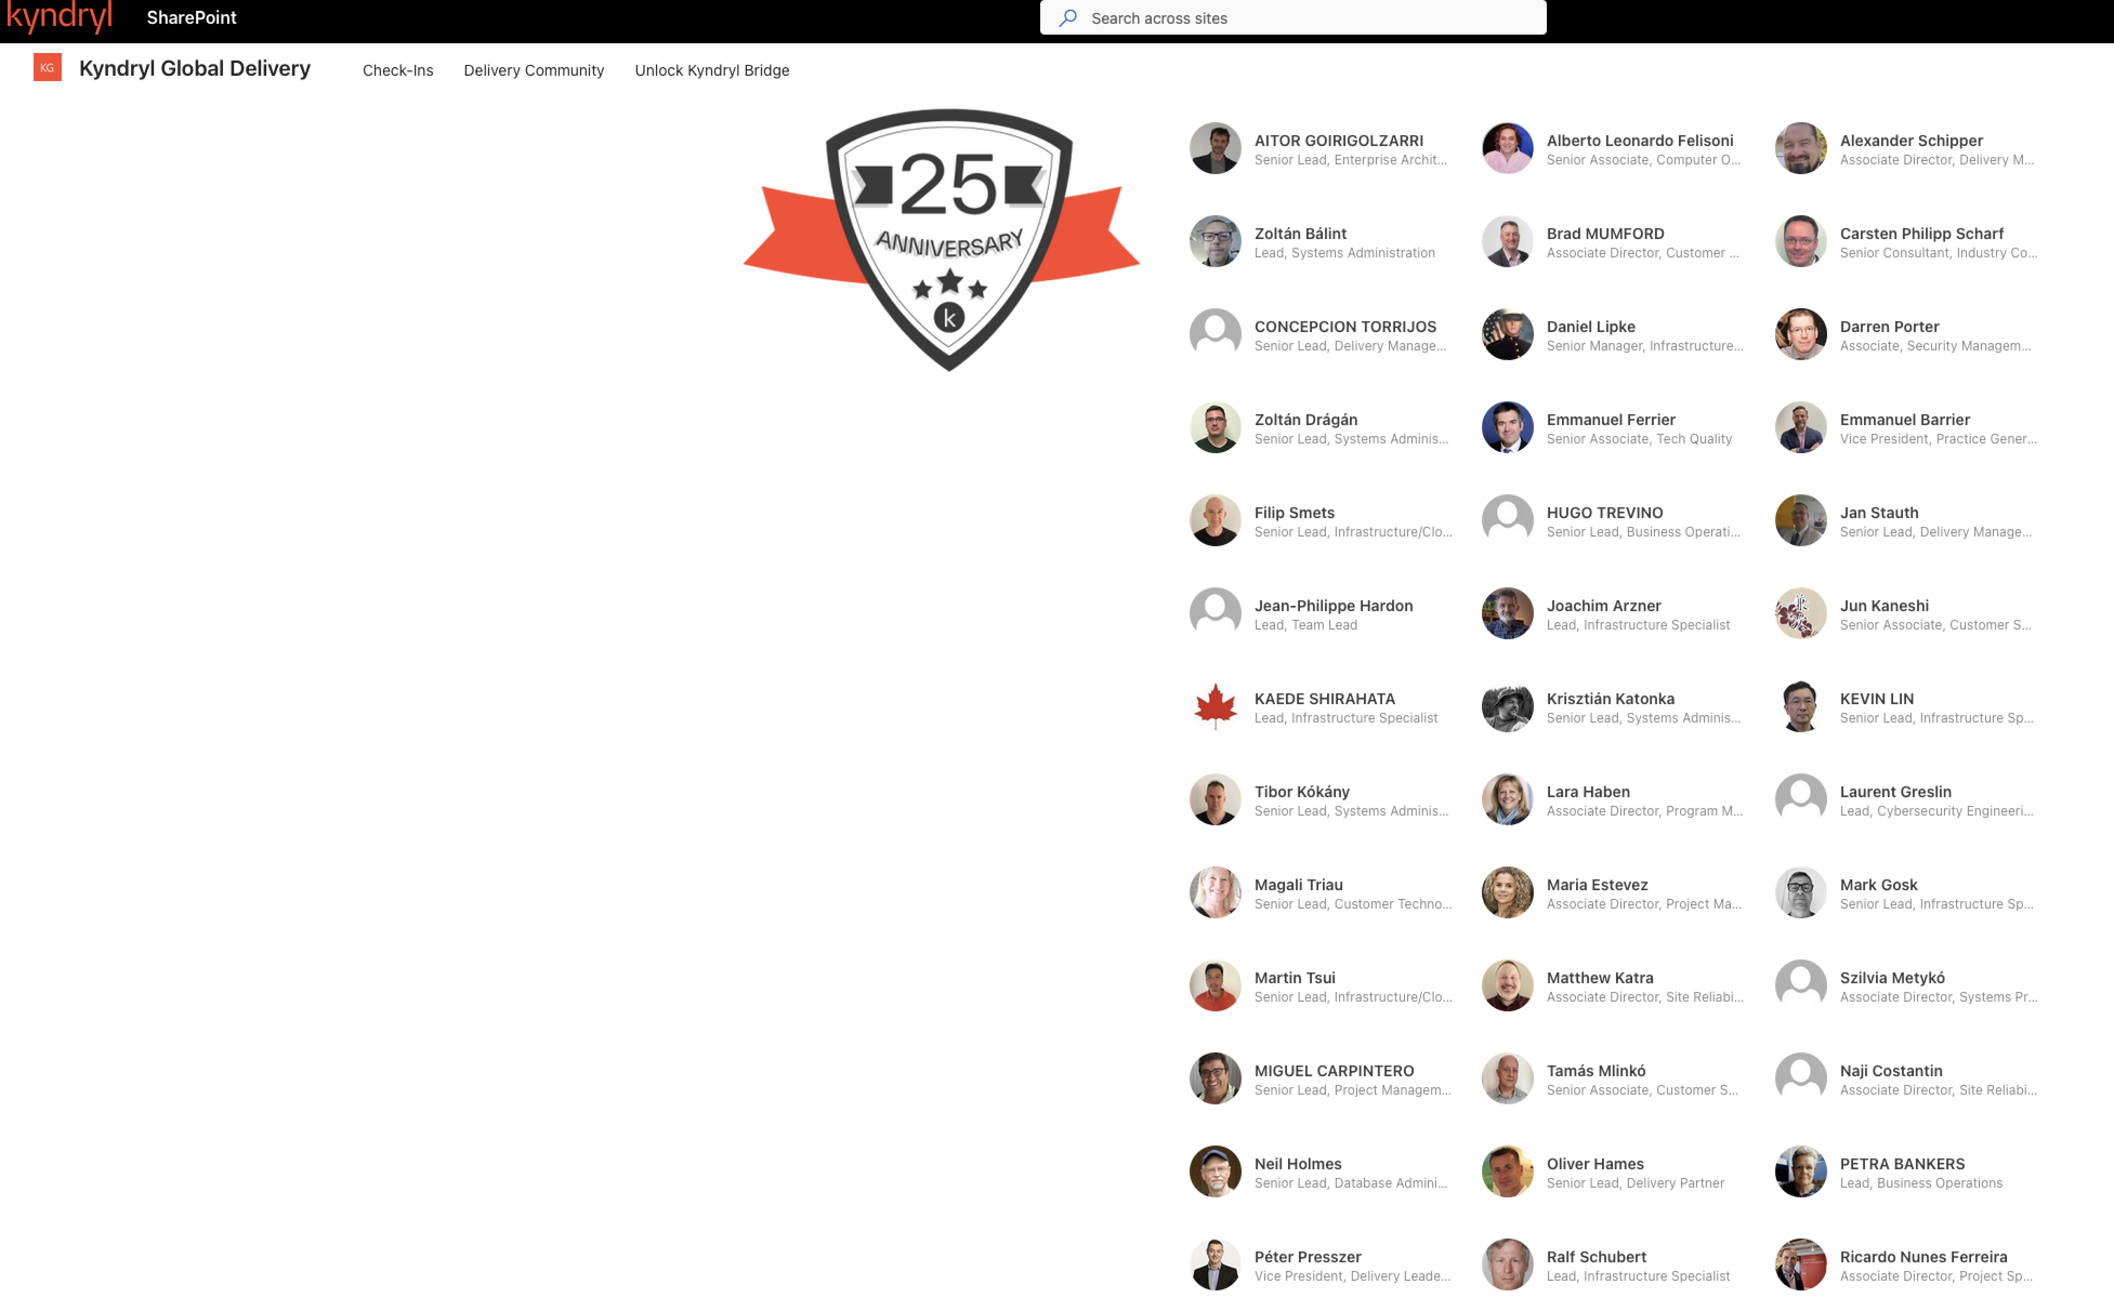
Font: https://kyndryl.sharepoint.com/sites/KyndrylGlobalDelivery/SitePages/Celebrating-the-journey-that-powers-our-success-%E2%80%93-May-2026.aspx?TeamsCID=51097a01-71e2-4bb9-87bc-d0cde72ad9ff&linkOpenTime=1780054904272

Slide 2
